Slide 1
Computational Thinking Module 1
Wednesday, 9 February 2022

Slide 2
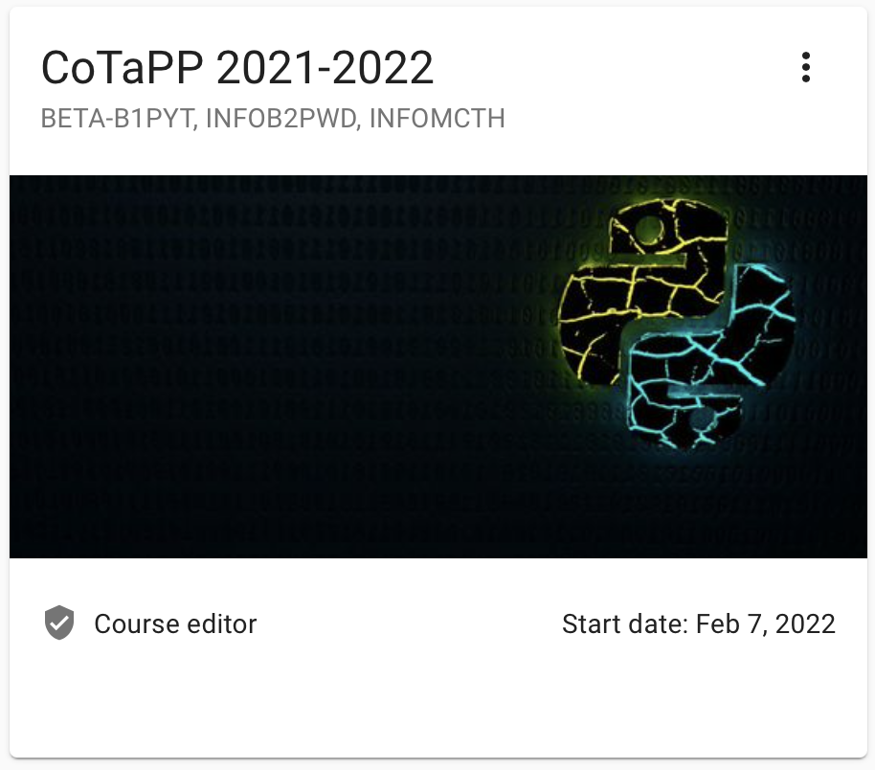
Quarterfall
A set of exercises to practice the new concepts will be made available in Quarterfall after each lecture.
You are expected to solve these exercises individually within one week after the respective lecture.
To be admitted to the exam, you must have completed and submitted on time at least 50% of the exercises in Quarterfall.
Login: https://pro.quarterfall.com
Can everyone login and see this week exercises?

Slide 3
Computational Thinking (1 hour)
In Quarterfall you can find the exercises for Module 1:
Download times
Maximal gain
Number segments
Quarters
Filter
Deadline: Wednesday, 16 of February – 23h30
Q & A sessions (online):
Monday: 17h15 – 19h00
Tuesday: 9h15 – 11h00
Wednesday: lab
Thursday: 15h15 – 17h00
Friday: 11h15 – 13h00

Slide 4
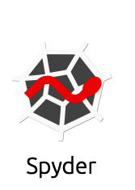

Anaconda Setup (30 minutes)
Install Anaconda:
https://docs.anaconda.com/anaconda/install/
On Anaconda.Navigator install:
Spyder
Jupyter notebook

